Slide 1

The Iron Man

Slide 2
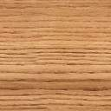




The Wooden Man P_{interactive} Winning Computer
ersonally
Leeds / PwC Apprentice Team
David Marples & Calum Wallbridge

Slide 3
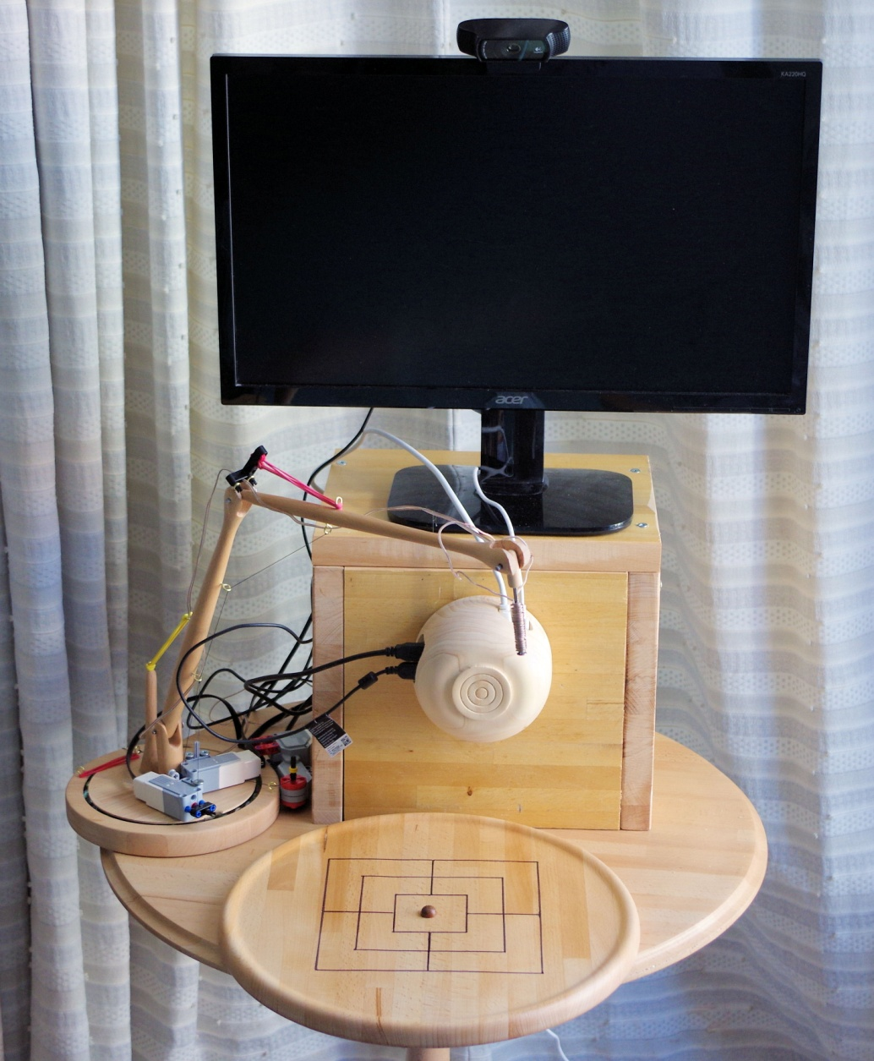
The Wooden Man

Slide 4
Project Elements
Aim: To create a robot capable of playing a range of board games using counters: initially Tic-Tac-Toe, Nine Mens Morris, and Draughts.
This requires:
Vision system
Robotic arm
AI players for games
“Operating System”

Slide 5
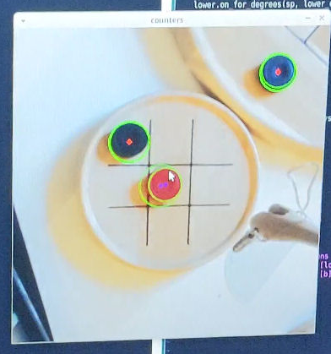
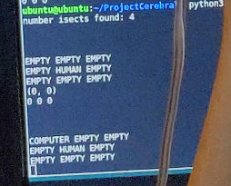
Vision System
Single webcam – monocular.
Viewing scene obliquely, so need to:
Rectify image
Identify board (and so game)
Identify objects of interest (e.g. Counters)

Slide 6
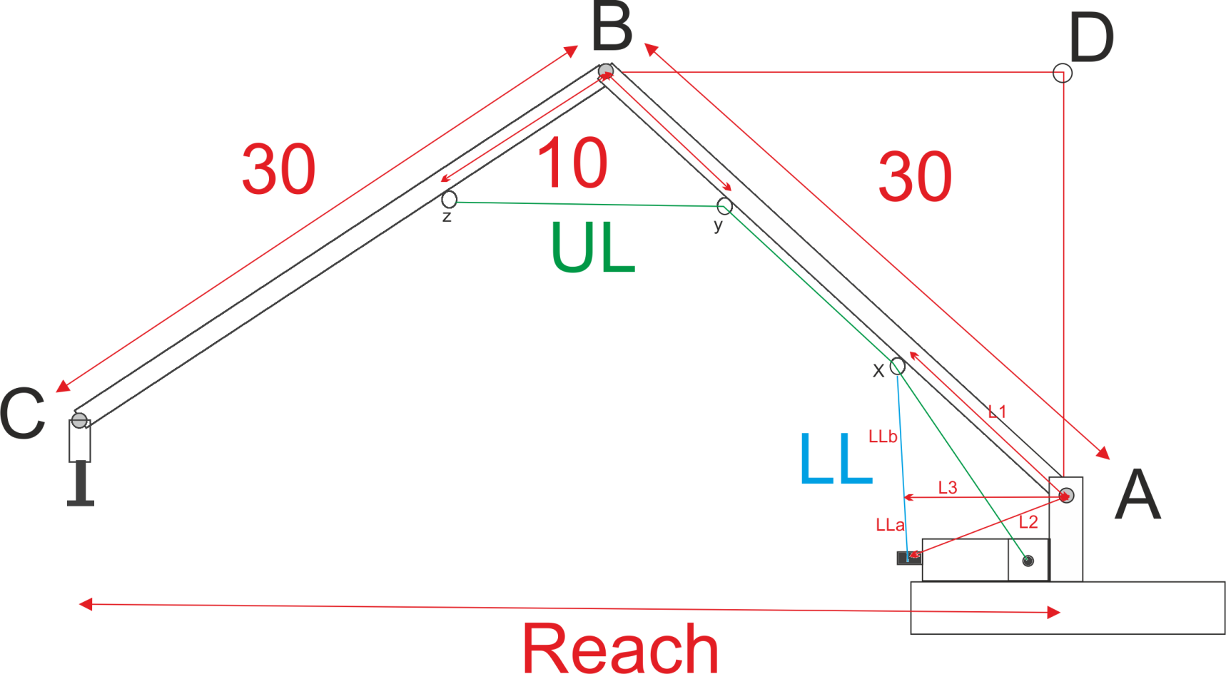
Robot Arm

Slide 7
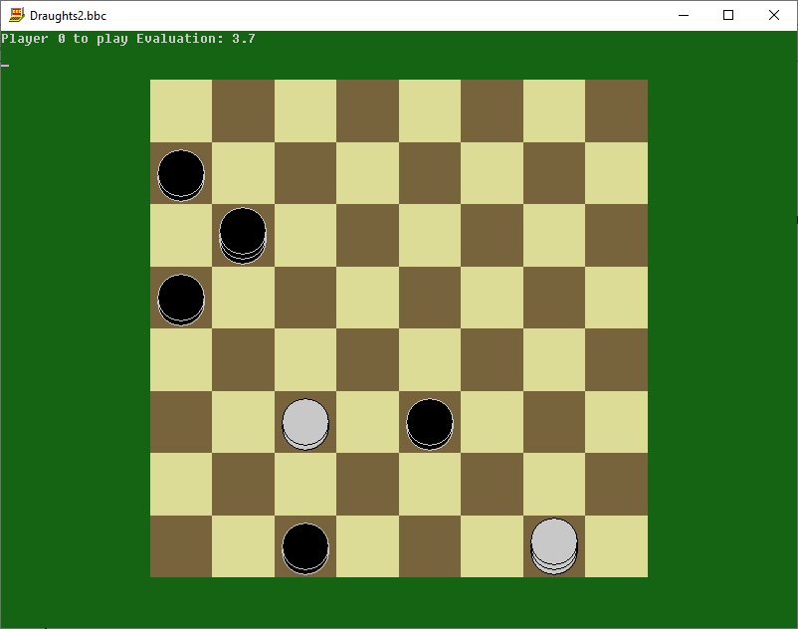
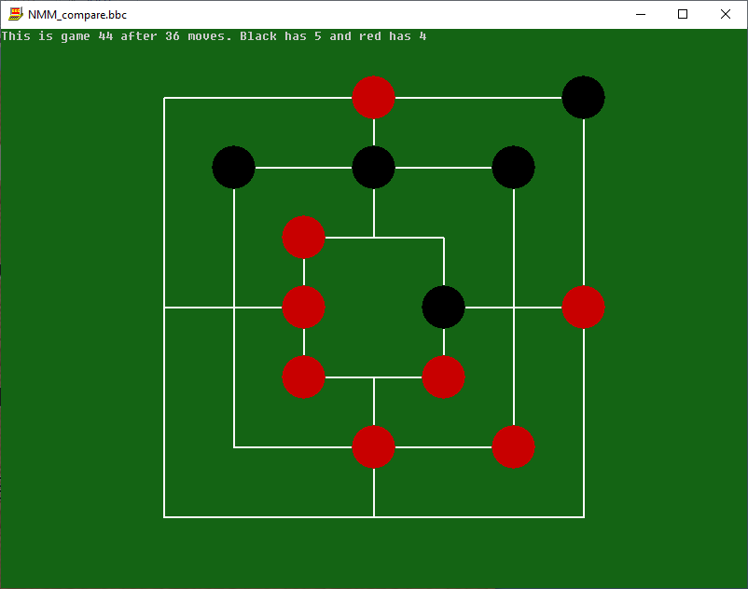
Artifical Intelligence
Rules – what is allowed?
Minimax -a way to choose
Position Evaluation – what matters?
Optimising parameters
How much can we generalise?

Slide 8
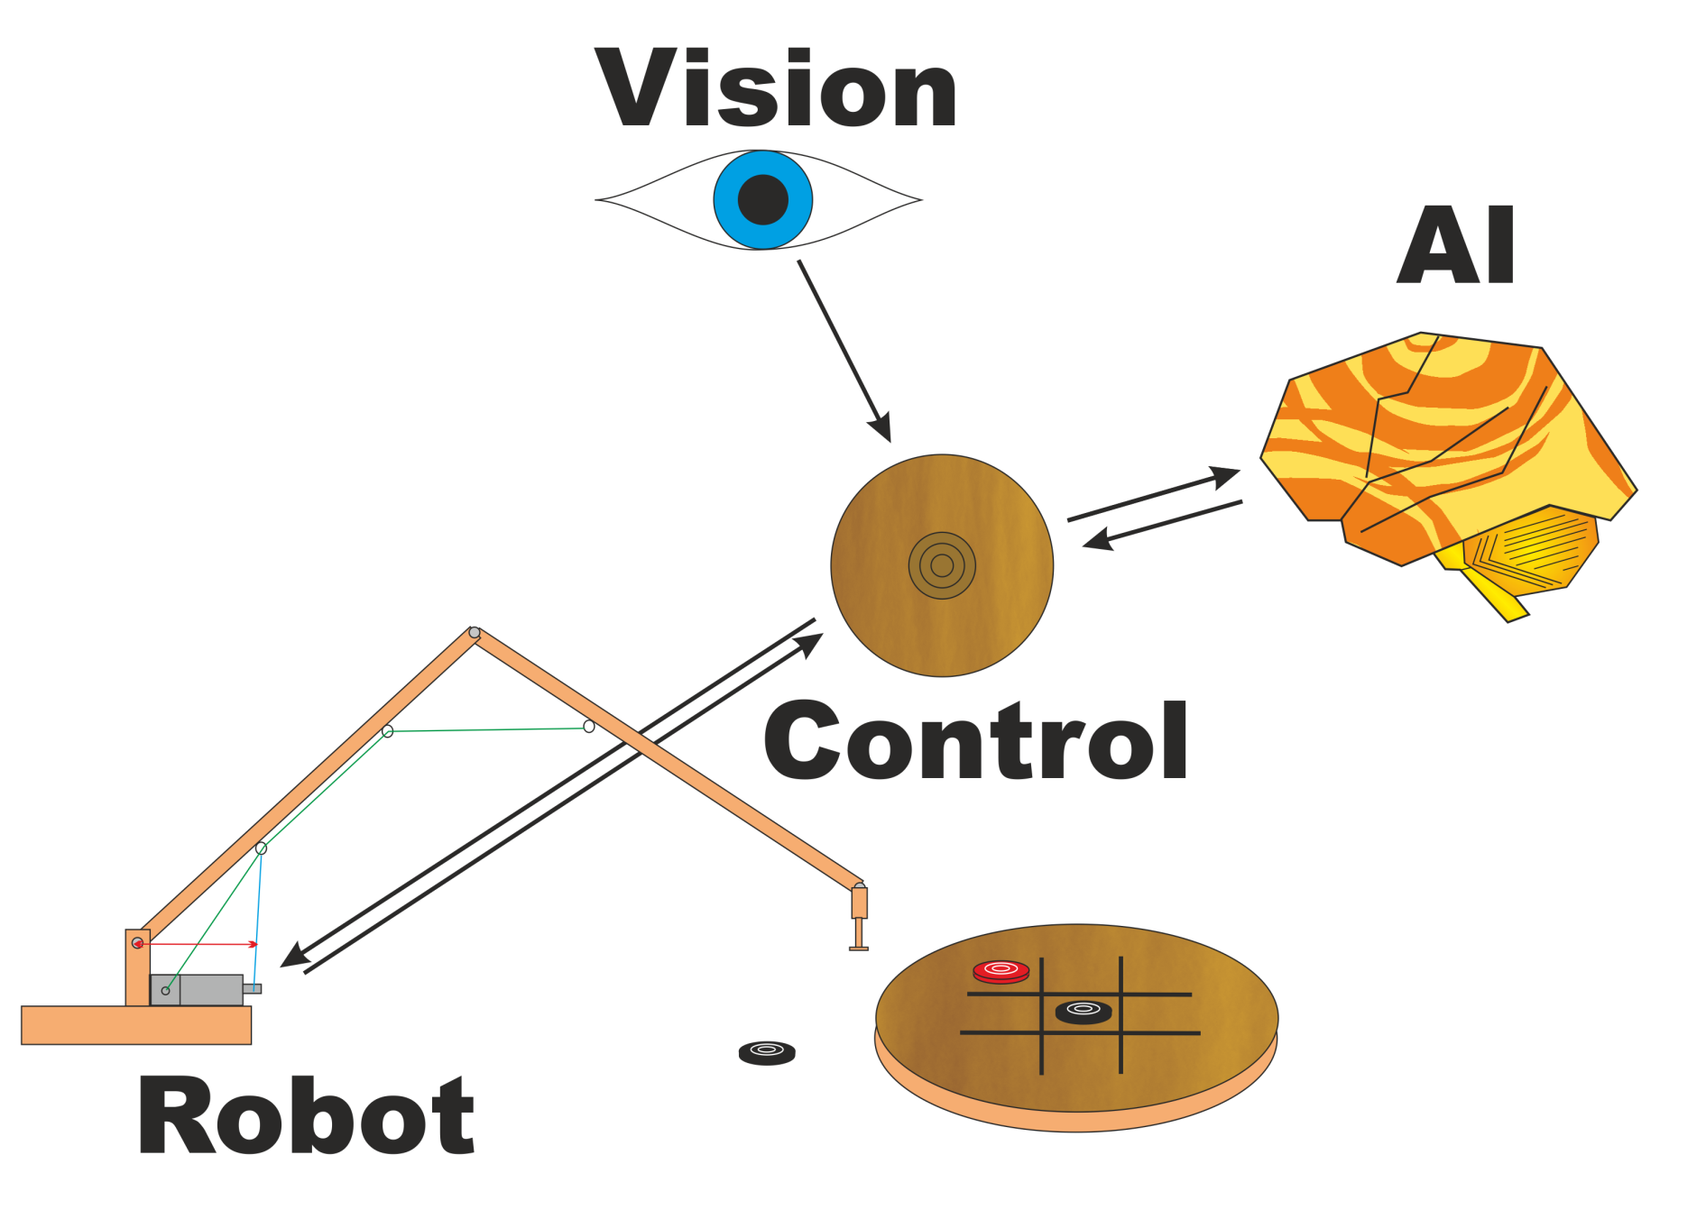
System Integration

Slide 9
Future Possibilities
Add extra games
Enhance robotic arm
More degrees of freedom
Better pick up options
Take motor / sensor control “in house”
Stereo vision system

Slide 10
Discussion Points
Communication between components
Vision system
Training/optimising the AI
Arm enhancements

